Slide 1
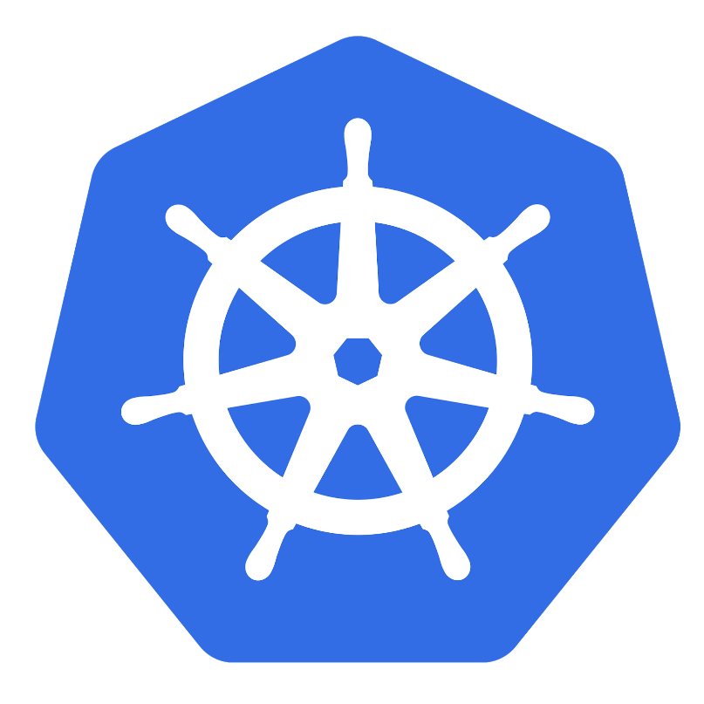
ICP sizing and typical deployments

Slide 2
Agenda
Typical platform deployments
Placement
Sizing

Slide 3
Workload segmentation and isolation
Workloads types
Topology and placement
Production requirements

Slide 4
ICP > Typical deployments From sandboxes to full HA clusters
Notes:
When ready, your existing data/apps can also be referenced from public cloud
When really ready, your private cloud becomes an assistant to move your workloads into IBM Cloud ... you choose region

Slide 5
IBM Cloud Private – all in one
Boot + Master + Proxy + Worker node
Public Docker Register
Local/Block Volumes
Local User Register
Desktop, OpenStack, VMware, POWERVM, zLinux
* Typical CE implementation

Slide 6
IBM Cloud Private – single management
Boot, Master and Proxy node
Worker node(s)
Worker node(s)
Calico Network (SDN)
File Server
Public or Private Docker Registry
Local User Registry
Shared Volumes
Calico Network (SDN)
Calico Network (SDN)
Block/local Volumes
Shared Volumes
persistent volumes
Shared Volumes
persistent volumes
Shared Volumes
Block Volumes
OpenStack, VMware, POWERVM, zLinux
* Typical CE implementation

Slide 7
IBM Cloud Private – Cluster containers only
Virtual IP
Virtual IP
Boot node
Enterprise
LDAP
Docker Client
Master nodes(3 or 5)
Proxy nodes(3 or 5)
Worker nodes(2-n)
Ansible based installer
Calico Network (SDN)
Calico Network (SDN)
Ansible based cluster mgnt
External Docker link
Network Segmentation
(policies, namespaces)
Config files
HA File Server
Calico Network (SDN)
Private Docker Registry
Shared Volumes
(Persistent volumes)
Node Segmentation
(node selectors)
LDAP Configuration
Shared Volumes
(Cluster volumes)
Shared Volumes
(Cluster volumes)
Shared Volumes
(Persistent volumes)
Block Volumes
Block Volumes
OpenStack, VMware, POWERVM, zLinux (Worker only)
* Typical CN or EE implementation

Slide 8
IBM Cloud Private – Cluster CAM only
Virtual IP
Virtual IP
Enterprise
LDAP
Boot node
Master nodes (3 or 5)
Proxy nodes (3 or 5)
Worker nodes
(1 - n)
CAM VMs (0 - n)
Ansible based installer
Calico Network (SDN)
Ansible based cluster mgnt
Calico Network (SDN)
Multi Cloud Mgnt
Docker Client
HA File Server
Config files
Network Segmentation
(policies, namespaces)
Automation (CAM)
Shared Volumes
(Persistent volumes)
Private Docker Registry
LDAP Configuration
Calico Network (SDN)
Shared Volumes
(Cluster volumes)
External Docker link
Shared Volumes
(Cluster volumes)
Shared Volumes
(Persistent volumes)
Block Volumes
Block Volumes
OpenStack, VMware
IBM Confidential

Slide 9
IBM Cloud Private – Management cluster (EE) CF services only
Virtual IP
Boot node
Enterprise
LDAP
CF nodes (17- n)
Ansible based installer
Ansible based cluster mgnt
External Docker link
Cloud Foundry
Services
Config files
HA File Server
Shared Volumes
(Persistent volumes)
CF SDN
Shared Volumes
(Cluster volumes)
Shared Volumes
(Persistent volumes)
Block Volumes
Block Volumes
OpenStack, VMware

Slide 10
IBM Cloud Private – Management cluster (EE) multi cloud
Virtual IP
Virtual IP
Enterprise
LDAP
Boot node
Master nodes (3 or 5)
Proxy nodes (3 or 5)
Worker nodes
(3 - n)
CF nodes(17 - n)
CAM VMs (0 - n)
Ansible based installer
Calico Network (SDN)
Ansible based cluster mgnt
Multi Cloud Mgnt
Cloud Foundry
Calico (SDN)
Automation (CAM)
Services
Docker Client
File Server
Config files
Network Segm.
Shared Vol.
(Persistent vol.)
Calico (SDN)
Private Docker Reg.
Node Segm.
(node selectors)
(CF SDN)
Shared Vol.
(Cluster vol.)
LDAP
External Docker link
Shared Vol.
(Cluster vol)
Shared Vol.
(Persistent vol.)
Shared Vol.
(Persistent vol.)
Block Vol.
Block Volumes
OpenStack, VMware, POWERVM*, zLinux*
* partial
IBM Confidential

Slide 11
ICP > Placement How to activate production environments?
Notes:
When ready, your existing data/apps can also be referenced from public cloud
When really ready, your private cloud becomes an assistant to move your workloads into IBM Cloud ... you choose region

Slide 12

One cloud, isolation across teams
Kubernetes Cloud
Namespace 1 Users: Quotas:
Namespace 2 Users: Quotas:
Service 1
10.4.5.6
Service 2
10.4.5.7
Quotas
Categories you can set quotes in a namespace:
Compute
Storage
Object count (pods, services, pvc, …)
Scope
Pod 1
Volume
Pod 2
Pod 3
Volume
Pod 4
kube-system Users: Quotas:
Objects created by the Kubernetes system
Master Nodes
Proxy Nodes
Worker Nodes
Master Nodes
Master Nodes
Master Nodes
Master Nodes
Master Nodes
Master Nodes
Notes:
https://kubernetes.io/docs/concepts/policy/resource-quotas/
Resource Quota objects are independent of the Cluster Capacity. They are expressed in absolute units. So, if you add nodes to your cluster, this does not automatically give each namespace the ability to consume more resources.

Slide 13
IBM Cloud private highly available topology
Management services are running in all the master nodes.
UI, kube-api service, docker registry (and so on) run in active/active mode
Virtual IP manager assigns virtual IP to one of the master nodes to serve the UI/API request
Other services rely on etcd to select a leading instance (you could treat them as active/passive mode)
The number of master nodes should be odd (per request of etcd to handle split brain issue)
Proxy services are running in all the proxy nodes in active/active mode
Virtual IP manager assigns virtual IP to one of the proxy nodes to serve application requests. The number of proxy nodes could be any value.

Slide 14
Your Workload – Levels of Availability
Load Balancer
Namespace
Namespace
Namespace
Service
Service
Service
Replica Set
Replica Set
Replica Set
Pod
Pod
Pod
Pod
Pod
Pod
Pod
One pod Good for development. Single pod with single log. Can fail over using same persistent volume
Multiple Pods Multiple pods in a replica set. One pod fails, load balance to 2nd pod with no downtime
Multiple Services Multiple services with a load balancer allows each replica set to run in a separate name space, cluster, even data center

Slide 15
ICp DC split everything
no stretched cluster
no segmentation
L_DC1
L_DC2
DMZ Internet
LDAP
ICp
Prod 1
ICp
Prod 2
ICp
Prod 3
ICp
Prod 4
ICp
Prod 5
ICp
Prod 16
ICp
Prod 17
ICp
Prod 18
ICp
Prod 19
ICp
Prod 20
CMDB
Docker Client
Image repo
App Catalog
Image repo
App Catalog
Image repo
App Catalog
Image repo
App Catalog
Image repo
App Catalog
Image repo
App Catalog
Image repo
App Catalog
Image repo
App Catalog
Image repo
App Catalog
Image repo
App Catalog
Update Server
File Server
(active)
File Server
(active)
File Server
(active)
File Server
(active)
File Server
(active)
File Server
(active)
File Server
(active)
File Server
(active)
File Server
(active)
File Server
(active)
File Server
(active)
File Server
(active)
File Server
(active)
File Server
(active)
File Server
(active)
File Server
(active)
File Server
(active)
File Server
(active)
File Server
(active)
File Server
(active)
vRA
DMZ BACK
End-point mgnt
ICp
Prod 6
ICp
Prod 7
ICp
Prod 8
ICp
Prod 9
ICp
Prod 10
ICp
Prod 21
ICp
Prod 22
ICp
Prod 23
ICp
Prod 24
ICp
Prod 25
Back-up
...
Image repo
App Catalog
Image repo
App Catalog
Image repo
App Catalog
Image repo
App Catalog
Image repo
App Catalog
Image repo
App Catalog
Image repo
App Catalog
Image repo
App Catalog
Image repo
App Catalog
Image repo
App Catalog
File Server
(active)
File Server
(active)
File Server
(active)
File Server
(active)
File Server
(active)
File Server
(active)
File Server
(active)
File Server
(active)
File Server
(active)
File Server
(active)
File Server
(active)
File Server
(active)
File Server
(active)
File Server
(active)
File Server
(active)
File Server
(active)
File Server
(active)
File Server
(active)
File Server
(active)
File Server
(active)
DR option
...
Intranet
ICp
Prod 11
ICp
Prod 12
ICp
Prod 13
ICp
Prod 14
ICp
Prod 15
ICp
Prod 26
ICp
Prod 27
ICp
Prod 28
ICp
Prod 29
ICp
Prod 30
Monitoring
...
Image repo
App Catalog
Image repo
App Catalog
Image repo
App Catalog
Image repo
App Catalog
Image repo
App Catalog
Image repo
App Catalog
Image repo
App Catalog
Image repo
App Catalog
Image repo
App Catalog
Image repo
App Catalog
SIEM
File Server
(active)
File Server
(active)
File Server
(active)
File Server
(active)
File Server
(active)
File Server
(active)
File Server
(active)
File Server
(active)
File Server
(active)
File Server
(active)
...
File Server
(active)
File Server
(active)
File Server
(active)
File Server
(active)
File Server
(active)
File Server
(active)
File Server
(active)
File Server
(active)
File Server
(active)
File Server
(active)

Slide 16
ICp reduced instances view (Scenario 6) – not considered
Stretched cluster due to the fact we have low latency between the different DC’s. Proof to be obtained – latency figures, stretched vlans, single LAN structure
Division/company segmentation – namespaces, node selector tags, calico network policies.
ICp zone split only
stretched cluster
segmentation
L_DC1
L_DC2
LDAP
DMZ Internet
CMDB
ICp
Prod 1
Docker Client
Image repo
App Catalog
File Server
(active)
file server
(active)
Update Server
vRA
DMZ BACK
End-point mgnt
ICp
Prod 2
Back-up
...
Image repo
App Catalog
File Server
(active)
file server
(active)
DR option
...
Intranet
Monitoring
ICp
Prod 3
...
Image repo
App Catalog
File Server
(active)
file server
(active)
SIEM
...

Slide 17
ICp DC split instances and companies view
no stretched cluster
Zone and company segmentation
L_DC1
L_DC2
LDAP
DMZ Internet
CMDB
ICp
Prod 1
ICp
Prod 2
Docker Client
Update Server
vRA
DMZ BACK
End-point mgnt
Back-up
...
DR option
...
Intranet
Monitoring
...
Image repo
App Catalog
Image repo
App Catalog
Image repo
App Catalog
Image repo
App Catalog
SIEM
...
File Server
(active)
File Server
(active)
File Server
(active)
File Server
(active)

Slide 18
Division logical segmentation and zones physical segmentation
No stretched cluster
Division/company segmentation – namespaces, node selector tags, calico network policies.
L_DC1
L_DC2
LDAP
DMZ FRONT
CMDB
ICp
Prod 1
ICp
Prod 4
Docker Client
File Server
(active)
File Server
(active)
file server
(active)
File Server
(active)
Update Server
Image repo
App Catalog
Image repo
App Catalog
vRA
DMZ BACK
End-point mgnt
ICp
Prod 2
ICp
Prod 5
Back-up
...
File Server
(active)
File Server
(active)
file server
(active)
File Server
(active)
Image repo
App Catalog
Image repo
App Catalog
DR option
...
INTRANET
Monitoring
ICp
Prod 3
ICp
Prod 6
...
File Server
(active)
File Server
(active)
file server
(active)
File Server
(active)
SIEM
Image repo
App Catalog
Image repo
App Catalog
...

Slide 19

ICP Node View (single DC)
L_DC1
Intranet
DR option
Client Access Network
(VLAN ...)
Calico overlay Network
PVN_BOOT
PVN_PROXY
PVN_MASTER
PVN_WORKER
1/2
3/5
3/5
3-n
ICp - Installer Code
Tech Components
Docker CE Vx.x
RHEL 7.2 or 7.3
FS daemon/client
Shared File Systems
private repo
binaries ICp
Tools: jq, Kubectl
Connectivity
RHSS
DockerHub
GITHub (IBM Chart)
ICp Code – Proxy
Tech Components
Docker CE Vx.x
RHEL 7.2 or 7.3
FS daemon/client
Shared File Systems
binaries ICp
Connectivity
RHSS
ICp Code – Master
Tech Components
Docker CE Vx.x
RHEL 7.2 or 7.3
FS daemon/client
Shared File Systems
private repo
binaries ICp
LogStach directory
Connectivity
RHSS
LDAP
ICp Code – Worker
Tech Components
Docker CE Vx.x
RHEL 7.2 or 7.3
FS daemon/client
Shared File Systems
binaries ICp
persistent volumes
Connectivity
RHSS
Monitoring
vRA
Backup
Client
Docker Client
end-point
mgnt
Monitoring
end-point
mgnt
Monitoring
end-point
mgnt
Monitoring
Management
Network
(VLAN ...)
PVN_FILE_SERVER
2-6
Persistent Storage Pool
(Storage sub system)
vSAN, FC, iSCSi, ETH
Flash Copy, storage replication, cloning
File Server software (Spectrum Scale, Gluster, VsphereVolume, Vmware Photon)
Tech Components
RHEL 7.2 or 7.3
Backup Client
Shared File Systems
private repo
binaries ICp
persistent volumes
Connectivity
RHSS for RHEL updates
Cont.
volume
ICp
Binary
SIEM
(Qradar)
LDAP
vRA
Monitor-ing
Image repo
App Catalog
Backup
Server
Endpoint mgnt
Update Server
RHSS
end-point
mgnt
Monitoring
Backup
Client

Slide 20
ICP Node View (single DC)
L_DC1
Intranet
DR option
Client Access Network
(VLAN ...)
Calico overlay Network
CF overlay Network
PVN_BOOT
PVN_PROXY
PVN_MASTER
PVN_WORKER
PVN_CF_CORE
PVN_CF_Cell
1/2
3/5
3/5
3-n
17-n
2-n
ICp - Installer Code
Tech Components
Docker CE Vx.x
RHEL 7.2 or 7.3
FS daemon/client
Shared File Systems
private repo
binaries ICp
Tools: jq, Kubectl
Connectivity
RHSS
DockerHub
GITHub (IBM Chart)
ICp Code – Proxy
Tech Components
Docker CE Vx.x
RHEL 7.2 or 7.3
FS daemon/client
Shared File Systems
binaries ICp
Connectivity
RHSS
ICp Code – Master
Tech Components
Docker CE Vx.x
RHEL 7.2 or 7.3
FS daemon/client
Shared File Systems
private repo
binaries ICp
LogStach directory
Connectivity
RHSS
LDAP
ICp Code – Worker
Tech Components
Docker CE Vx.x
RHEL 7.2 or 7.3
FS daemon/client
Shared File Systems
binaries ICp
persistent volumes
Connectivity
RHSS
CF Director + Diego + CF
Tech Components
RHEL 7.2 or 7.3
FS daemon/client
...
Shared File Systems
binaries Director + Diego + CF
persistent volumes
Connectivity
RHSS
Syndicate Services
CF Proxy
CF Cell
Tech Components
RHEL 7.2 or 7.3
FS daemon/client
...
Shared File Systems
binaries CF Cell
persistent volumes
Connectivity
RHSS
Syndicate Services
Monitoring
vRA
Backup
Client
Docker Client
end-point
mgnt
Monitoring
end-point
mgnt
Monitoring
end-point
mgnt
Monitoring
end-point
mgnt
Monitoring
end-point
mgnt
Monitoring
Management
Network
(VLAN ...)
PVN_FILE_SERVER
2-6
Persistent Storage Pool
(Storage sub system)
vSAN, FC, iSCSi, ETH
Flash Copy, storage replication, cloning
File Server software (Spectrum Scale, Gluster, VsphereVolume, Vmware Photon)
Tech Components
RHEL 7.2 or 7.3
Backup Client
Shared File Systems
private repo
binaries ICp
persistent volumes
Connectivity
RHSS for RHEL updates
Cont.
volume
ICp
Binary
SIEM
(Qradar)
LDAP
vRA
Monitor-ing
Image repo
App Catalog
Backup
Server
Endpoint mgnt
Update Server
RHSS
end-point
mgnt
Monitoring
Backup
Client

Slide 21
Implications of isolated clusters across the DCs
Image syncronisation
impact: having no synchronisation could lead to faulty deployments or the 2 DCs running different images.
possible solution: Repository is placed on a shared file system, this shared file system can be mirrored between the 2 DC’s
App center syncronistaion
impact: having no synchronisation could lead to faulty deployments or the 2 DCs running different images.
possible solution: Create helm repo (HTTP server, Github, ... needs shared file system replicated across DCs) and use the resync button if needed.
Appliction deployment across DC
impact: no synchronisation could lead to faulty deployments or the 2 DCs running different images.
possible solution: process orchestration needs to be setup so we deploy the 2 sides and configure the load balancing
FEDERATION OF INSTANCES WILL ADDRESS THOSE ISSUES
Desired Federation State
Policy Engine
Cluster Control Plane
Auth
Migration
Controllers
C1
C2

Slide 22
Don’t forget the physical layer
Management
vMotion
vSAN
VxLAN
PN_MGNT_POD
PN_EDGE_POD
PN_COMP_POD
PN_MGNT_POD
PN_EDGE_POD
PN_COMP_POD
1-n
1-n
1-n
1-n
1-n
1-n
vSAN Manager
vSAN Manager
NSX Manager
NSX Manager
NSX controllers 4 MNGT
NSX controllers 4 MNGT
vCenter
vSAN controller
vSAN controller
vCenter
vSAN controller
vSAN controller
vSphere
NSX controllers 4 edge
NSX controllers 4 compute
vSphere
NSX controllers 4 edge
NSX controllers 4 compute
ESXi
ESXi
ESXi
ESXi
ESXi
ESXi
NSF (?)
NSF (?)
NSF (?)
NSF (?)
NSF (?)
NSF (?)
CPU / MEM
CPU / MEM
CPU / MEM
CPU / MEM
CPU / MEM
CPU / MEM
ETH ports
ETH ports
ETH ports
ETH ports
ETH ports
ETH ports
SAN ports (?)
SAN ports (?)
SAN ports (?)
SAN ports (?)
SAN ports (?)
SAN ports (?)
Disk
Disk
Disk
Disk
Disk
Disk
Persistent Storage Pool
(Storage sub system)
FC, iSCSi
Persistent Storage Pool
(Storage sub system)
FC, iSCSi

Slide 23
ICP > Sizing Determining what workloads, how they behave ...
Notes:
When ready, your existing data/apps can also be referenced from public cloud
When really ready, your private cloud becomes an assistant to move your workloads into IBM Cloud ... you choose region

Slide 24
Sizing steps
The following process outlines steps for estimating the sizing and basic architecture for for customers looking to install IBM Cloud Private:
1
Identify the customer’s platform & workload types, as well as cluster requirements
2
Quantify cores/CPUs, along with nodes & pods needed in the cluster
3
Create High Level design and validate assumptions and calculations
4
Apply the pricing model & provide a quote to the customer

Slide 25
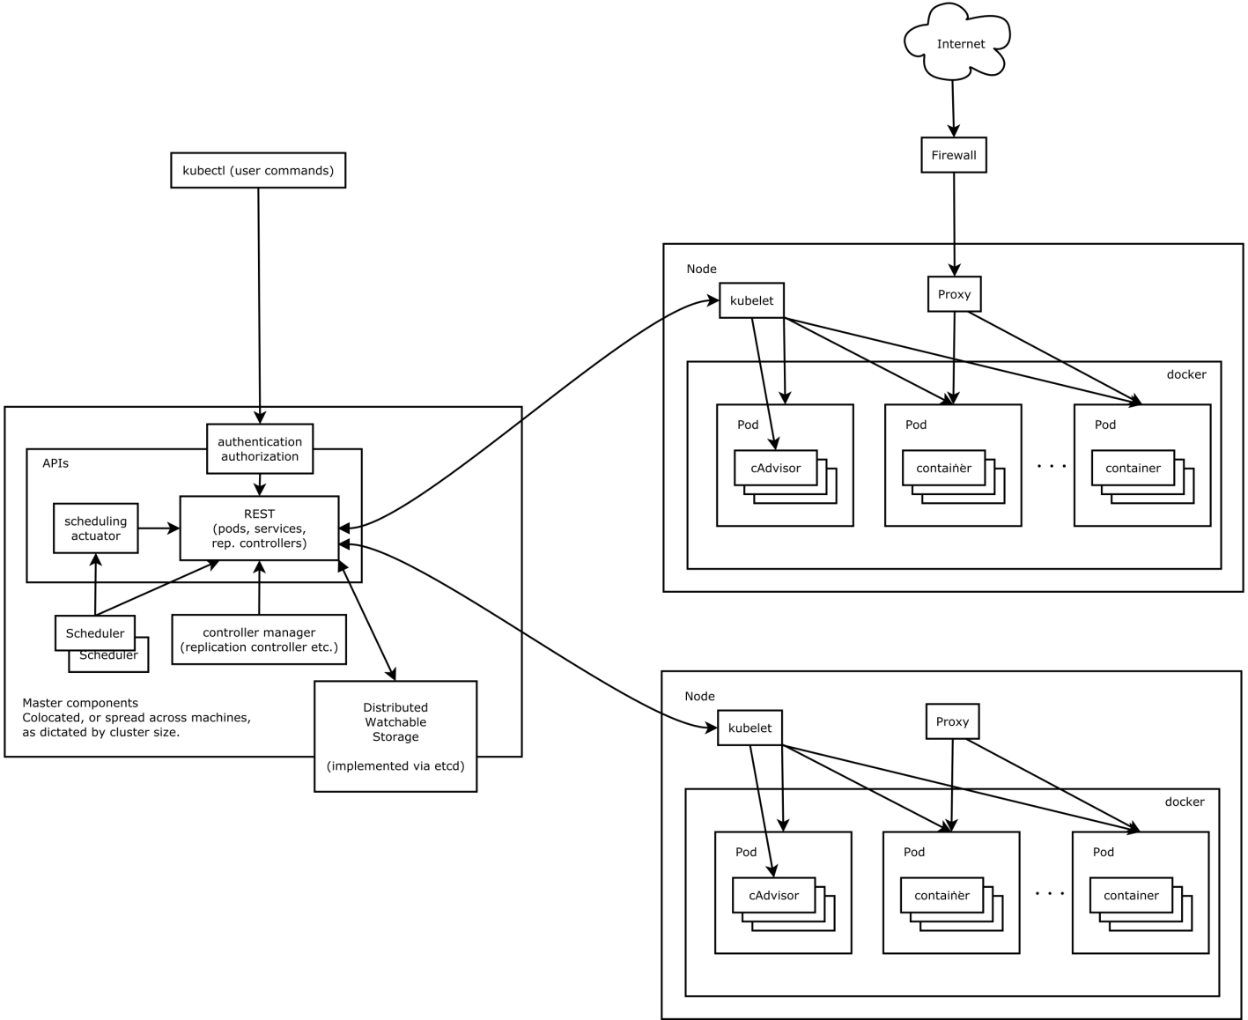
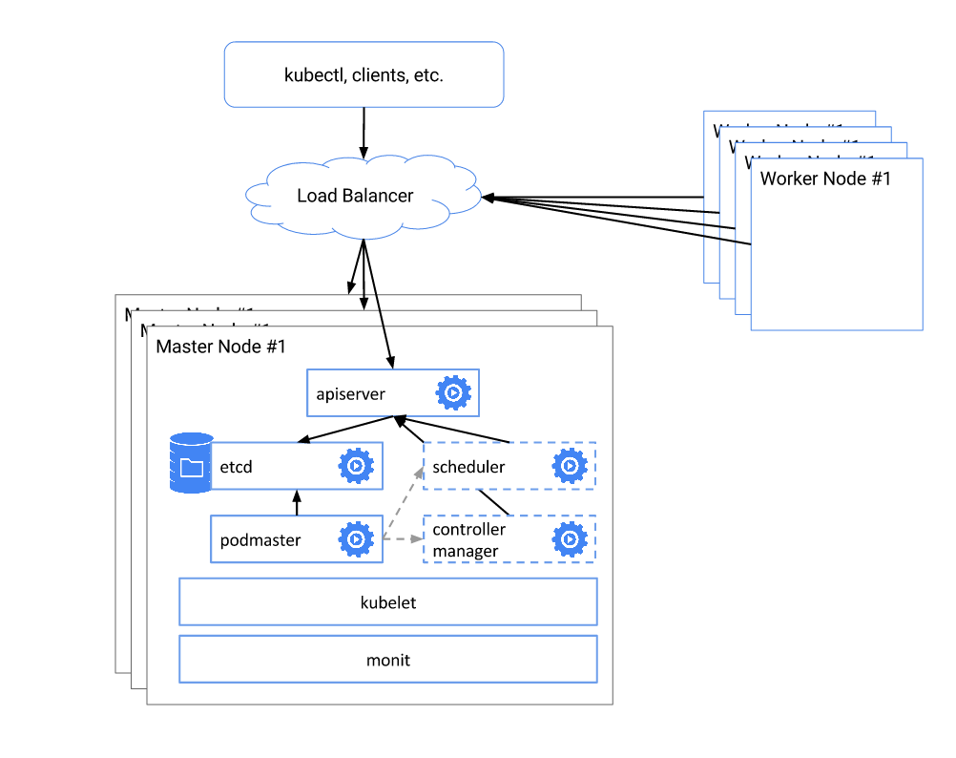

Key concepts for sizing & architecture estimation
The following process outlines steps for estimating the sizing and basic architecture for for customers looking to install IBM Cloud Private:
Cluster: A group of at least one master and multiple worker nodes.
Node: A worker machine in the cluster. A node may be a VM or physical machine, depending on the cluster. Every worker node represents a compute host where you can deploy, run, and manage containerized apps.
Pod: A group of one or more containers with shared storage / network, and a specification for how to run the containers.
Container: An allocation/portioning/assignment of host (compute) resources such as CPU and RAM.
Capacity: Describes the resources available on the node: CPU, memory, and the max number of pods that can be scheduled onto the node.
Cluster

Slide 26
Step 1: Identify platform & workload types for cluster(s)
What kind of workloads are you planning to migrate/run on IBM Cloud Private? (heritage, microservices)
What is your platform type? [BM or VM] What type of servers and how many? How many VMs?
How many clusters are needed? [dev/test/prod] Will you need HA/Redundancy?
Workload Type
Platform Type
Cluster Requirements
For heritage workloads, some customers may have separate VMs for each application instance (AI), where the # of AIs / VMs will equal the number of pods.
In these scenarios, be sure to ask about VM specs (cores per VM)
For microservices workloads be sure to understand the dynamic behaviour
When evaluating how many servers or VMs will be in use, be sure to confirm # of cores per machine.
Understand the needs of your workload to determine the type of worker nodes - elasticsearch needs large nodes with high memory
Also verify whether your customer expects this environment to grow within the next years.
Look at the isolation and segmentation as this can increase the node numbers
You should also be sure to verify with your customer whether they need HA and DR
Check whether the current environment size already accounts for redundancy / HA.
How many environments are needed and how are they placed over the different DCs.

Slide 27

Step 1.1 – Workload and workload sizing
Step 1.1 – Workload and workload sizing
Core Operational Services
Open Source
IBM Software
Monitoring Service
Prometheus or BYO
Logging Service
Elk or BYO
Metering Service
Product Insights
Security
Identiyy and Access Management
LDAP integration and RBAC
Vulnerability Advisor (beta)
Toolchains & Runtimes
Jenkins
Apache Tomcat Open Liberty
Messaging
RabbitMQ
Data Services
MongoDB
PostgreSQL
Redis
Clustering
Galera
Http Servers
Nginx
Terminal Access
Web Terminal
Toolchain & Runtimes
IBM Microservice Builder
IBM WebSphere Liberty
IBM SDK for Node.js
Messaging
IBM MQ Advanced for Developers
IBM MQ Advanced
Data Services
IBM Db2 Dev-C
IBM Data Server Manager (for Db2 Dev-C)
IBM Db2 Direct Advanced Edition / AESE
with Data Server Manager
IBM Db2 Warehouse Dev-C
IBM Db2 Warehouse Enterprise*
IBM Cloudant Developer Edition
Multi-cloud Management
IBM Cloud Automation Manager
Data Science
IBM Data Science Experience Developer Edition
IBM Data Science Experience Local*
Integration
IBM Integration Bus for Developers
IBM Integration Bus
IBM DataPower Gateway for Developers
IBM DataPower Gateway Virtual Edition
App Modernization Tooling IBM Transformation Advisor
Monitoring
IBM Cloud Application Performance
Management for DevOps (beta)
HPC
IBM Spectrum LSF Community Edition
+
Develop or bring your own…
*coming soon
Self written, community and open source compatible with Kubernetes 1.7

Slide 28


Step 1.1 – Workload and workload sizing
Step 1.1 – Workload and workload sizing
Extend workload provisioning with Cloud Automation Manager
Template driven provisioning of private and public cloud infrastructure: Bare-metal servers, VMs, cloud native services & complex application stacks
Open Source Catalog ⁽¹⁾
Enterprise Catalog ⁽¹⁾
MEAN stack – VMware, Azure, AWS, IBM Cloud
LAMP stack – VMware, Azure, AWS, IBM Cloud
Node.js – VMware, IBM Cloud
Strongloop – VMware, IBM Cloud
MariaDB - VMware
MongoDB – VMware, IBM Cloud
MongoDB Strongloop 3 tier – VMware, IBM Cloud
Virtual Servers with SSH key – AWS, IBM Cloud
Apache HTTP Server - VMware
Apache Tomcat - VMware
IBM DB2 EE (v10.5 & v11.1) - VMware
IBM MQ (v8 & v9) - VMware
IBM WebSphere Application Server ND (v11.1) - VMware
IBM WebSphere Liberty (v17) - VMware
IBM HTTP Server (v8.5.5, v9) - VMware
Oracle DB Enterprise (v12c) - VMware
Oracle MySQL (v5.7) - VMware
IBM Buildpacks
WebSphere Liberty
Runtime Buildpacks
Node.js
Swift
.Net
Automation content available with IBM Cloud Private purchase. Product licenses must be purchased separately or BYOL. See pricing and packaging for more information.
Bring your own Buildpacks
Add additional open source or private
+
+
Community Templates
Bring your own templates
Hashicorp Terraform Registry
Self written, IBM Cloud Schematics, etc

Slide 29
Step 1.2 – Platform type and needs
L_DC1
L_DC2
LDAP
DMZ FRONT
CMDB
ICp
Prod 1
ICp
Prod 4
Docker Client
File Server
(active)
File Server
(active)
file server
(active)
File Server
(active)
Update Server
Image repo
App Catalog
Image repo
App Catalog
vRA
DMZ BACK
End-point mgnt
ICp
Prod 2
ICp
Prod 5
Back-up
...
File Server
(active)
File Server
(active)
file server
(active)
File Server
(active)
Image repo
App Catalog
Image repo
App Catalog
DR option
...
INTRANET
Monitoring
ICp
Prod 3
ICp
Prod 6
...
File Server
(active)
File Server
(active)
file server
(active)
File Server
(active)
SIEM
Image repo
App Catalog
Image repo
App Catalog
...

Slide 30
Step 1.3 – Cluster Requirements and placement
Load Balancer
Namespace
Namespace
Namespace
Service
Service
Service
Replica Set
Replica Set
Replica Set
Pod
Pod
Pod
Pod
Pod
Pod
Pod
One pod Good for development. Single pod with single log. Can fail over using same persistent volume
Multiple Pods Multiple pods in a replica set. One pod fails, load balance to 2nd pod with no downtime
Multiple Services Multiple services with a load balancer allows each replica set to run in a separate name space, cluster, even data center

Slide 31
Step 2: Quantify CPUs/cores, nodes & pods
What is the CPU & memory footprint of the workloads? [size of compute environment = # CPUs]
How many nodes does your cluster need? How many pods?
How many cores or virtual cores will your cluster use?
Nodes & Pods
Cores & CPUs
Use this formula to calculate the amount of nodes needed: Expected # Pods in Cluster / # of Pods per Node
Once you’ve determined the number nodes needed, you can allocate the total CPU needed amongst these nodes (along with other resources like storage) to illustrate the architecture
If you and your customer are able to determine the number of VPCs (cores, CPUs), you can generate a basic quote.
You can also use these figures (# VMs & Total CPU) to do a conversion to nodes & pods for determining the customer’s container architecture.

Slide 32
Step 3 – Create High Level design and validate assumptions and calculations
L_DC1
Intranet
DR option
Client Access Network
(VLAN ...)
Calico overlay Network
CF overlay Network
PVN_BOOT
PVN_PROXY
PVN_MASTER
PVN_WORKER
PVN_CF_CORE
PVN_CF_Cell
1/2
3/5
3/5
3-n
17-n
2-n
HW Specifications
SW Specifications
Tech Components
Shared File Systems
Network specifications Connectivity
HW Specifications
SW Specifications
Tech Components
Shared File Systems
Network specifications
Connectivity
HW Specifications
SW Specifications
Tech Components
Shared File Systems
Network specifications
Connectivity
HW Specifications
SW Specifications
Tech Components
Shared File Systems
Network specifications
Connectivity
Isolation specifications
HW Specifications
SW Specifications
Tech Components
Shared File Systems
Network specifications
Connectivity
HW Specifications
SW Specifications
Tech Components
Shared File Systems
Network specifications
Connectivity
Isolation specifications
Monitoring
vRA
Backup
Client
Docker Client
end-point
mgnt
Monitoring
end-point
mgnt
Monitoring
end-point
mgnt
Monitoring
end-point
mgnt
Monitoring
end-point
mgnt
Monitoring
Management
Network
(VLAN ...)
PVN_FILE_SERVER
2-6
Persistent Storage Pool
(Storage sub system)
vSAN, FC, iSCSi, ETH
Flash Copy, storage replication, cloning
HW Specifications
SW Specifications
File Server Type
Tech Components
Shared File Systems
Network specifications
Connectivity
Cont.
volume
ICp
Binary
SIEM
(Qradar)
LDAP
vRA
Monitor-ing
Image repo
App Catalog
Backup
Server
Endpoint mgnt
Update Server
RHSS
end-point
mgnt
Monitoring
Backup
Client

Slide 33
Step 3: Apply pricing model & provide quote
# of VPCs
Worker nodes
Price per VPC*
Base price for IBM Cloud private platform
Sizing & Pricing Model
X
=
Licensed monthly or perpetual
Licensed monthly or perpetual
VPC/Node Type | Part Number | Chargeable Component | Price
Perpetual License | D1URTLL | IBM Cloud Private (CN) Virtual Processor Core License + SW Subscription & Support | $6,000
Term | D1US3LL | IBM Cloud Private (CN) Virtual Processor Core Monthly License | $250
Perpetual License | ? | IBM Cloud Private (EE) Virtual Processor Core License + SW Subscription & Support | $20,400
Term | ? | IBM Cloud Private (EE) Virtual Processor Core Monthly License | $850

Slide 34
Thank You
Notes:
When ready, your existing data/apps can also be referenced from public cloud
When really ready, your private cloud becomes an assistant to move your workloads into IBM Cloud ... you choose region

